Slide 1
eBaja
Octavio Duran – Budget Liason​
Brendon Jameson - CAD / Manufacturing Engineer​
Benjamin Plis - Test Engineer​
Abriana Romero - Project Manager​
Jared Walker - Logistics​

Slide 2
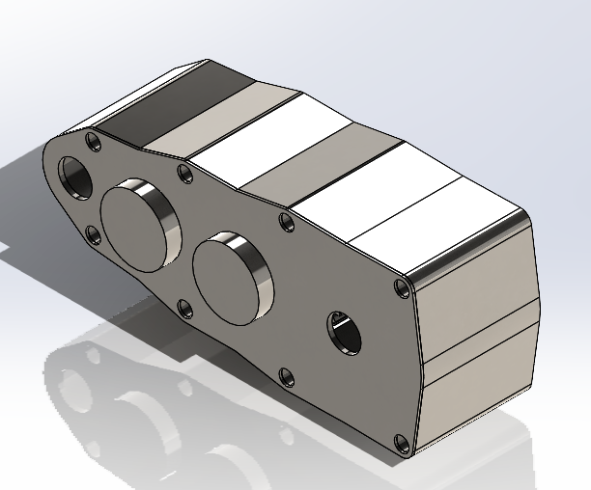
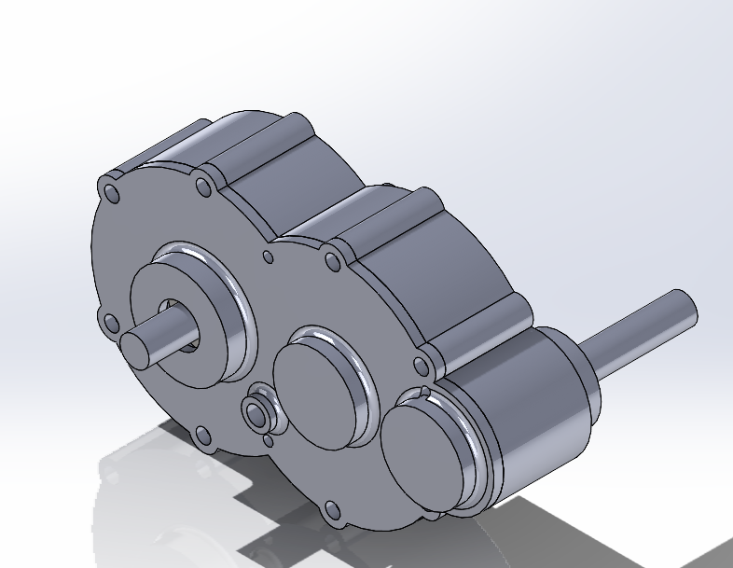
Design Efforts
Brendon Jameson 21F13​​
03/01/22

Slide 3
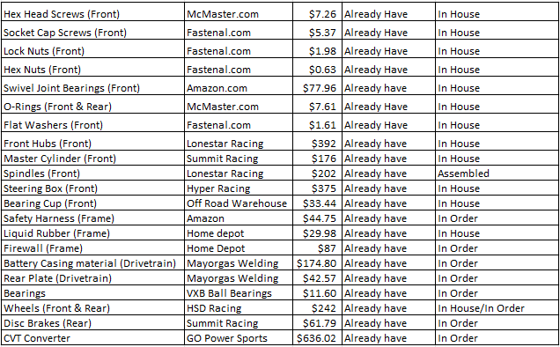
Purchasing Plan
BUDGET: $3,650
REMAINING BALANCE: $981.45
ALREADY PURCHASED
NEED TO PURCHASE
Octavio Duran 21F13​​
03/01/22

Slide 4
Manufacturing Plan
Abriana Romero 21F13​​
03/01/22

Slide 5
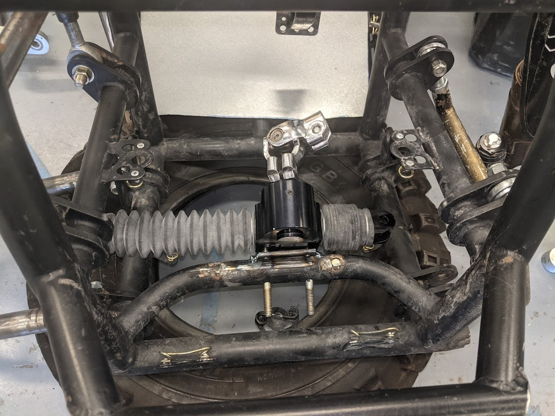
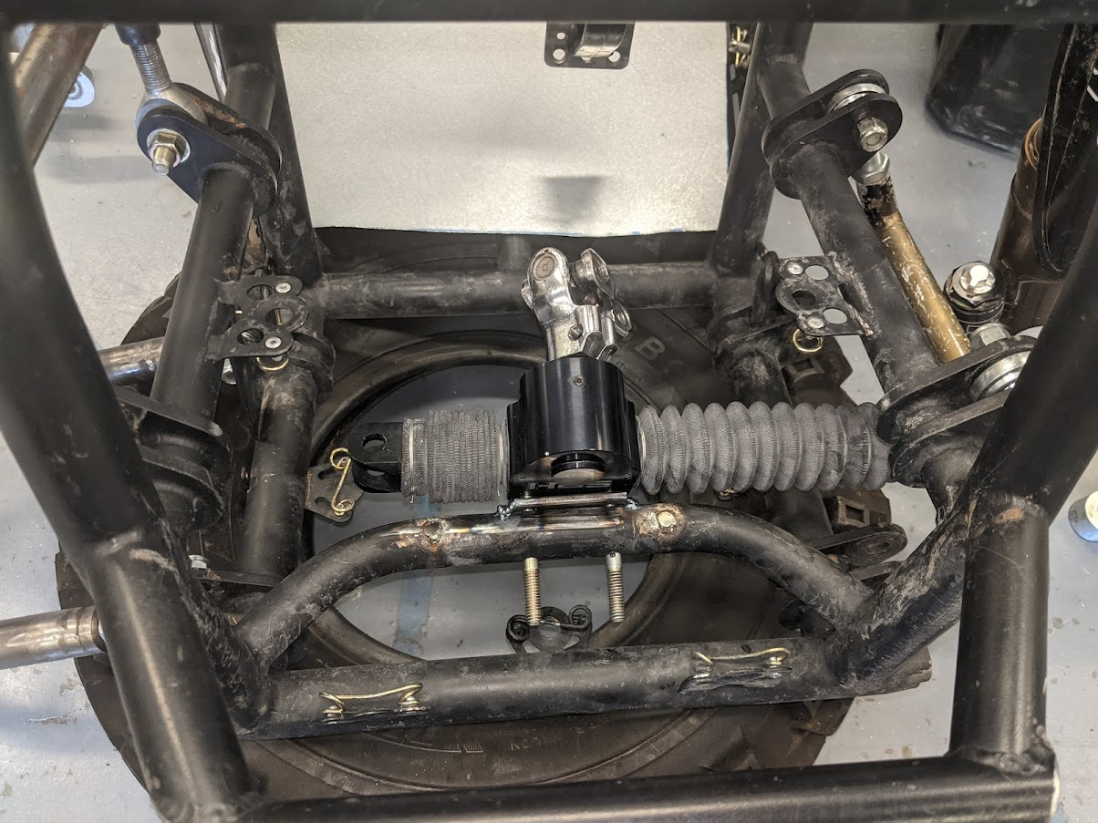
Demonstration
Benjamin Plis 21F13​
03/01/22

Slide 6
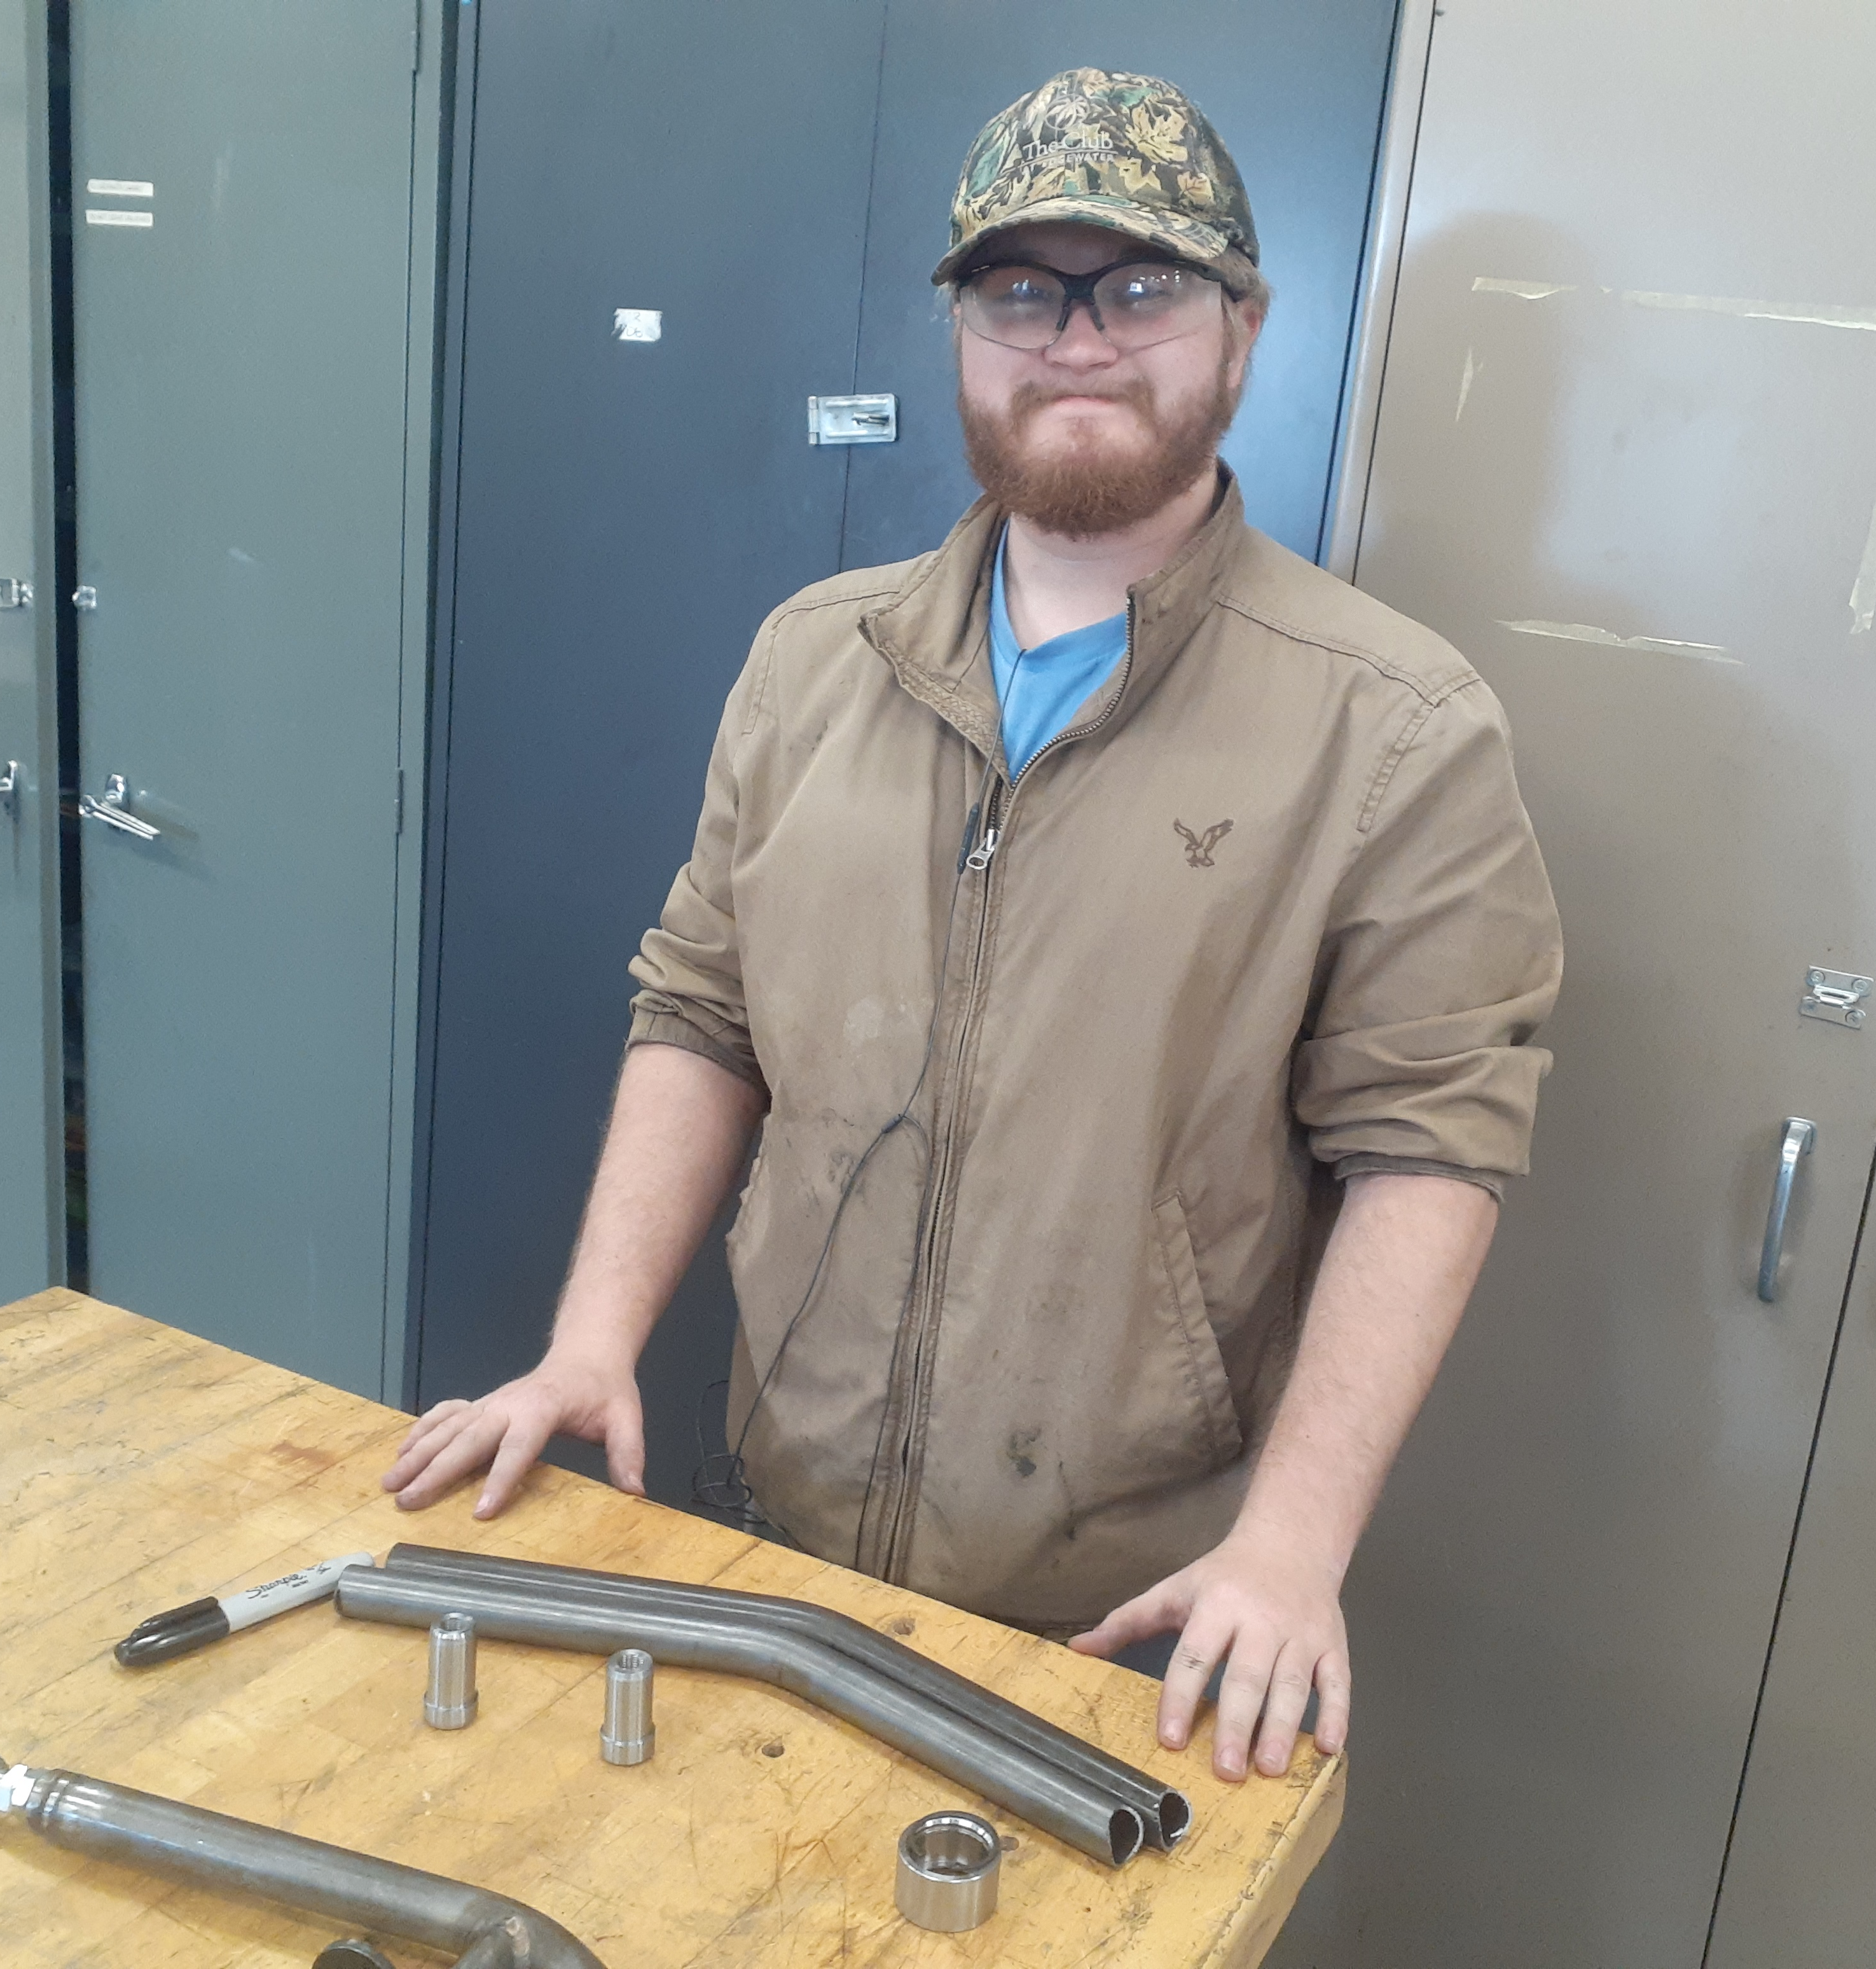
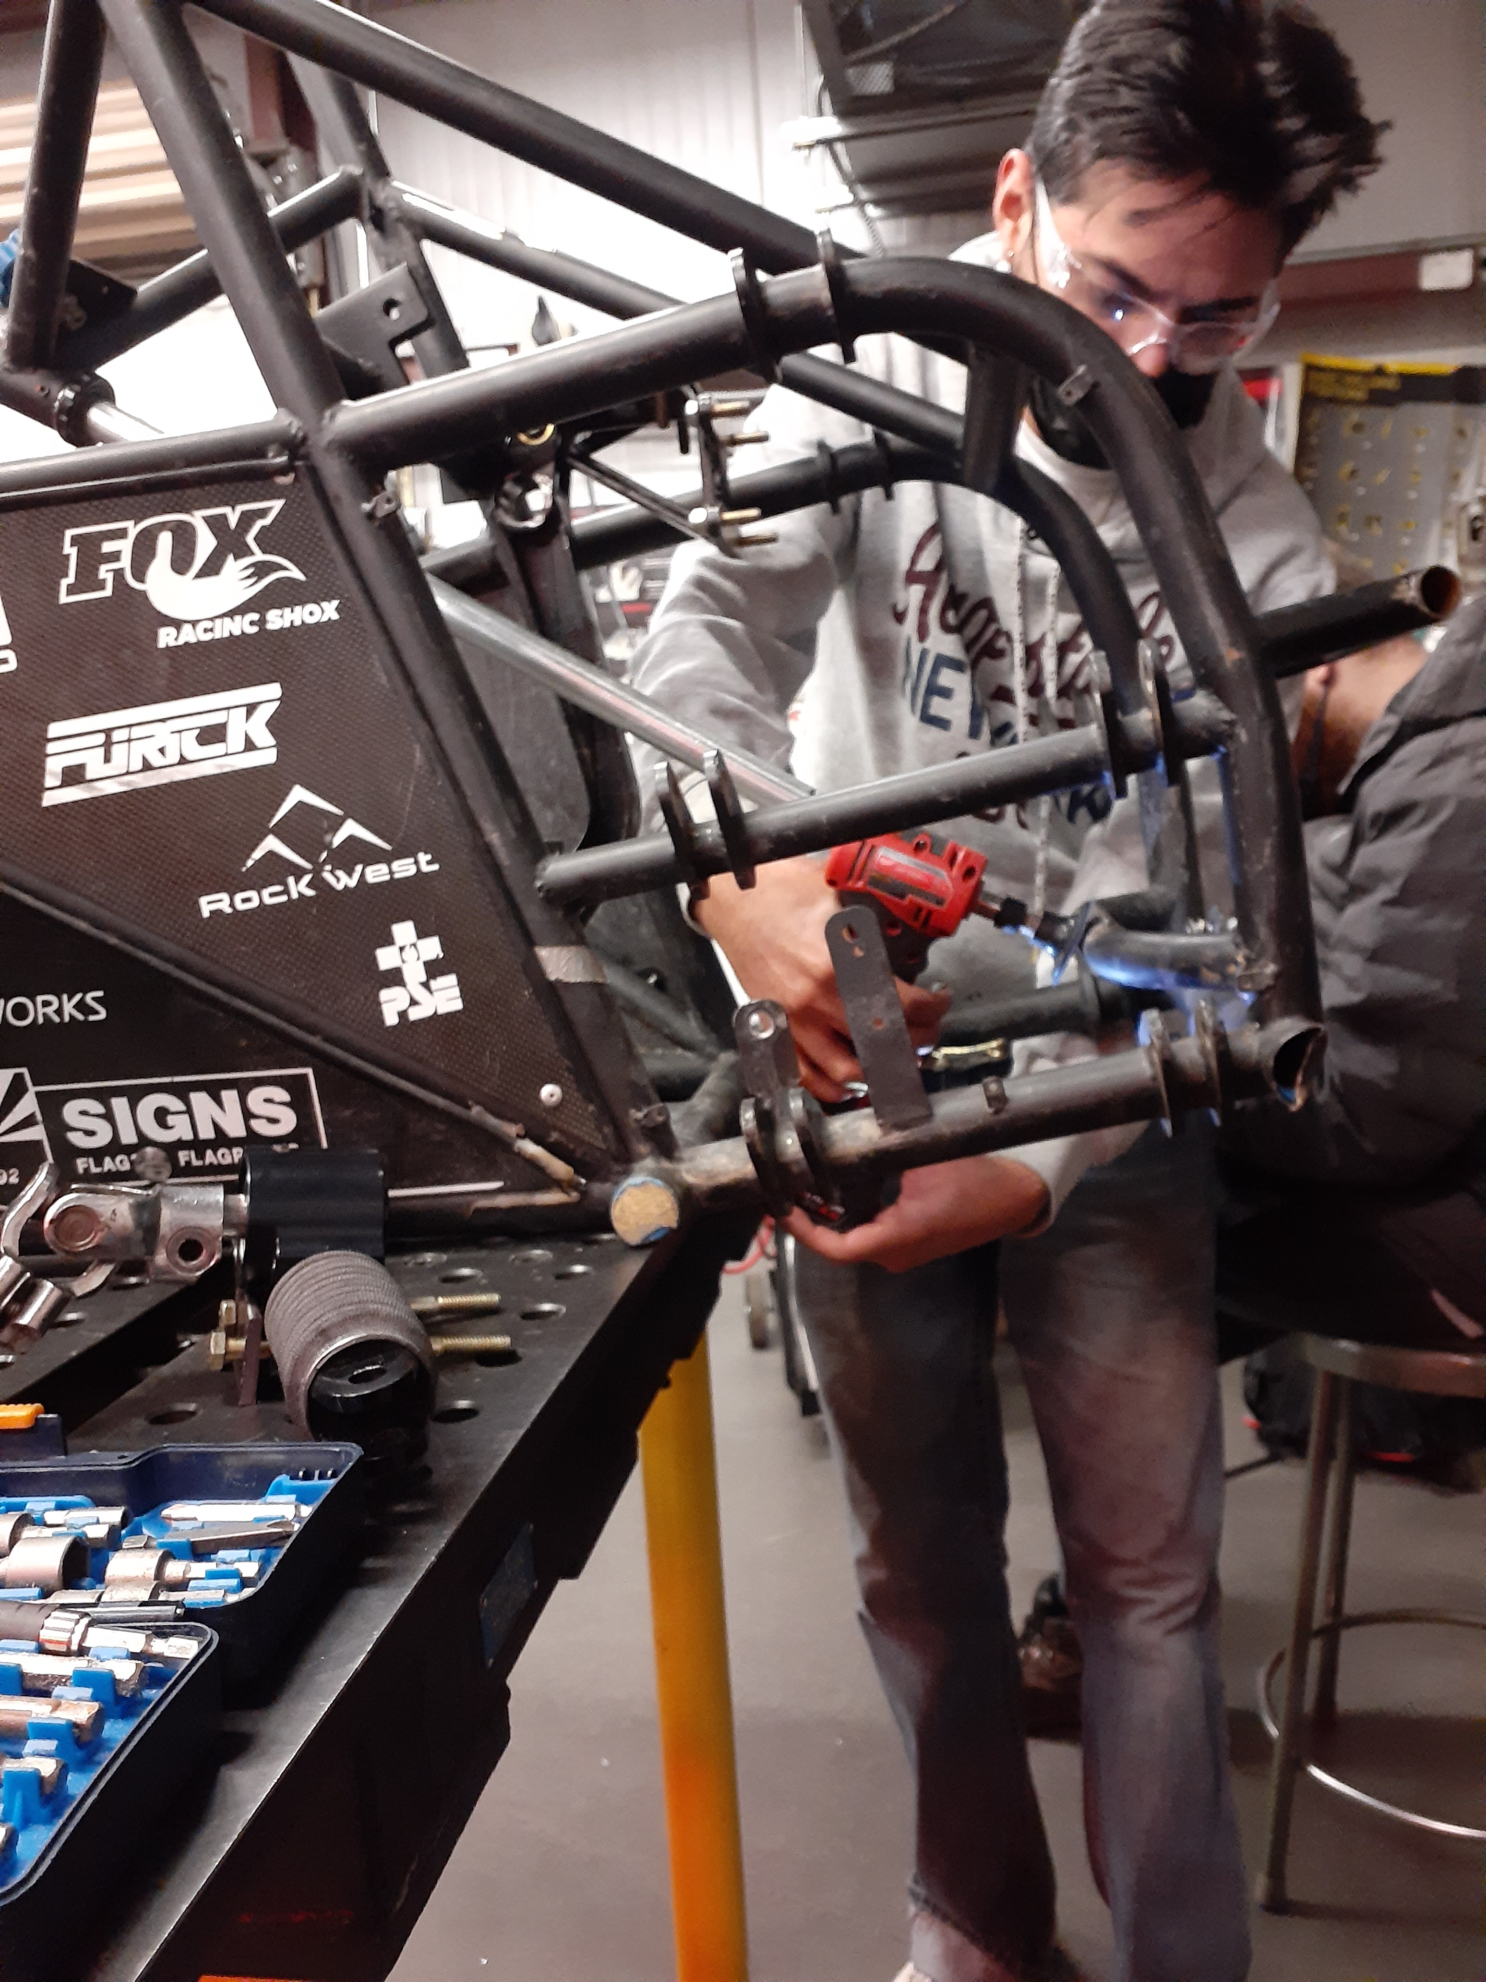
Demonstration
Jared Walker 21F13​​
03/01/22

Slide 7
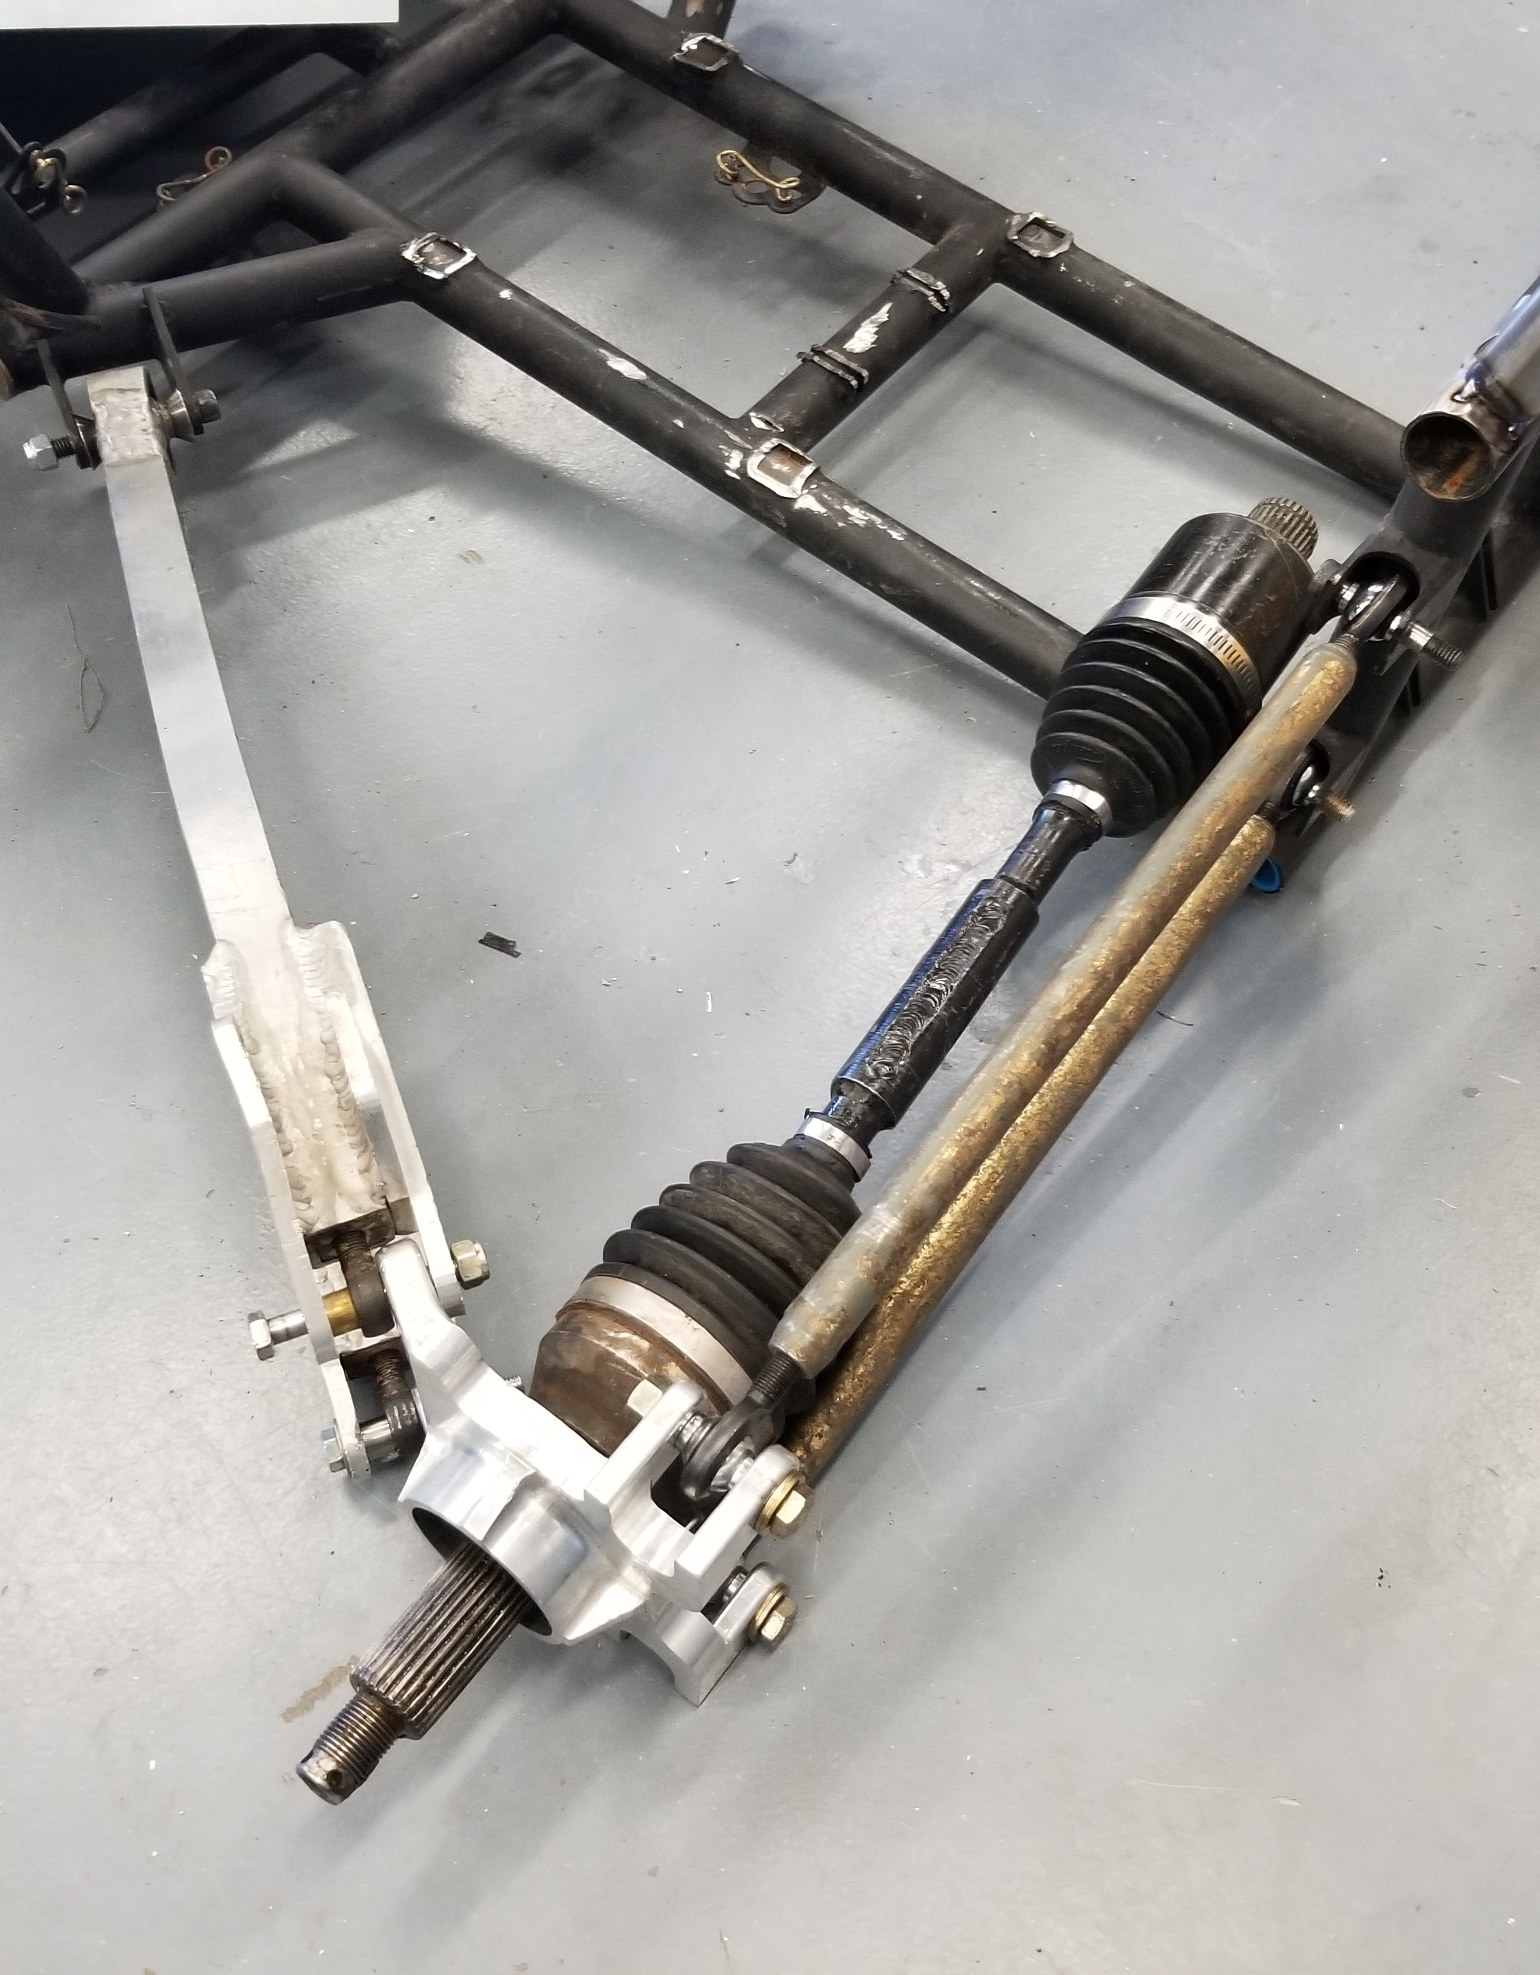
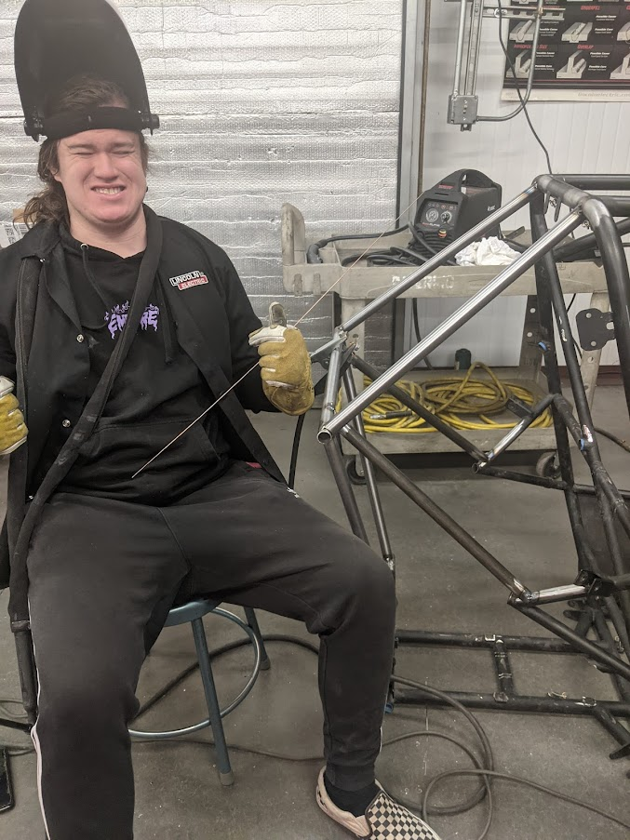
DEMONSTRATION
Abriana Romero 21F13
03/01/22

Slide 8
Demonstration - Steering
Benjamin Plis, Jared Walker 21F13​​
03/01/22

Slide 9
Gantt Chart
Octavio Duran 21F13​
03/01/22

Slide 10
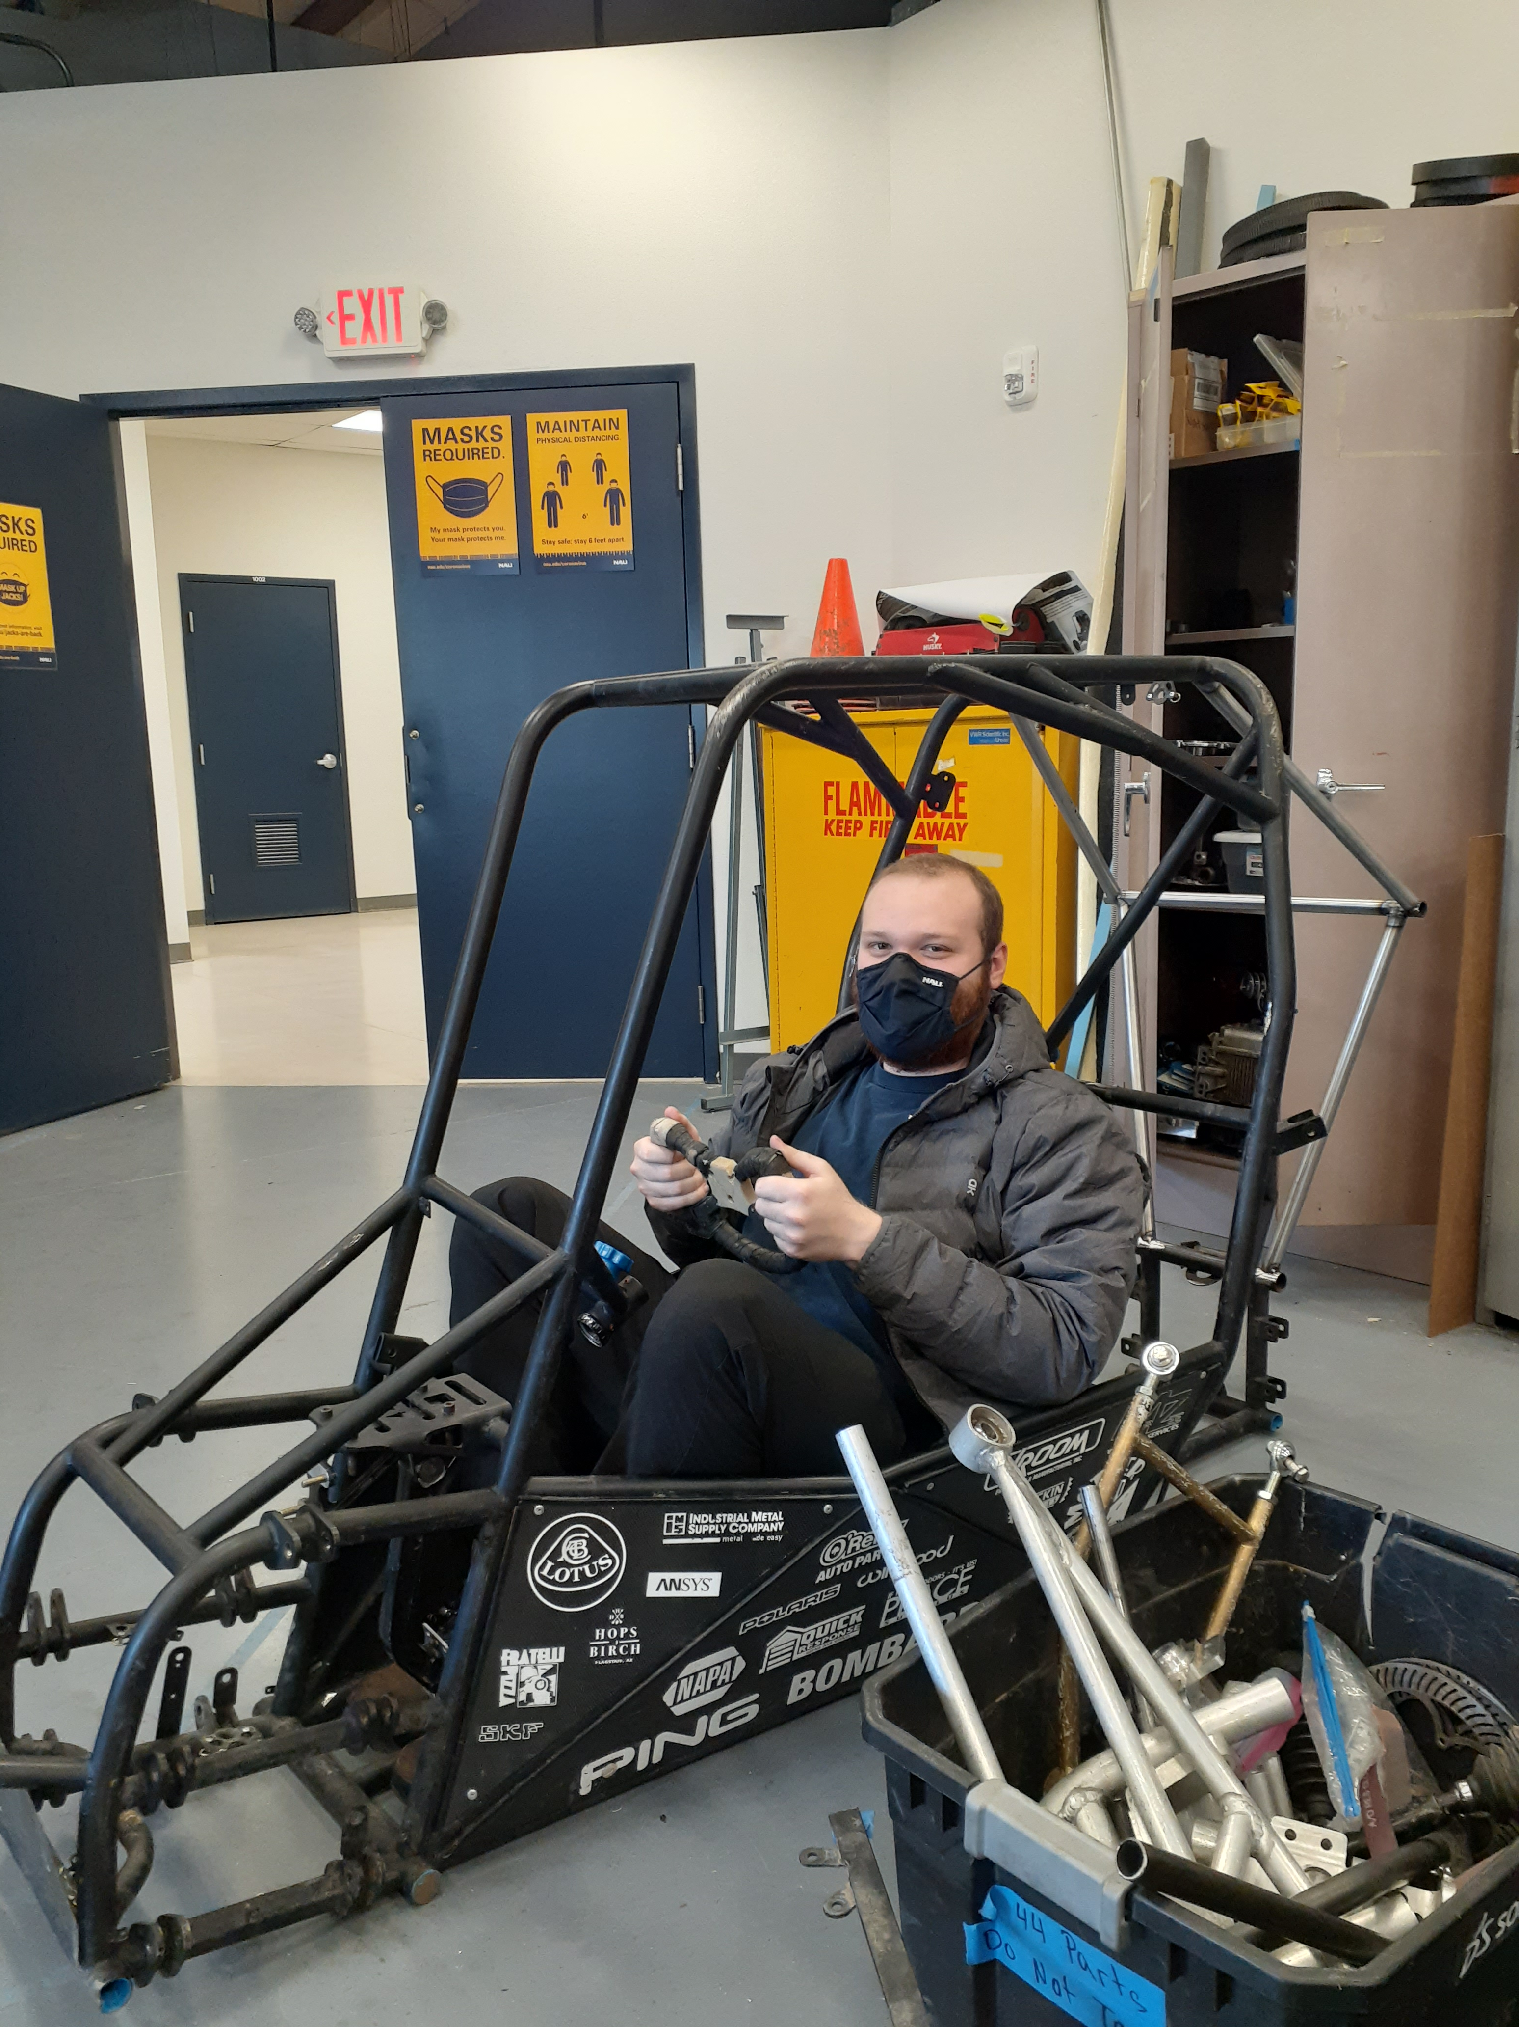
Questions?

